Slide 1
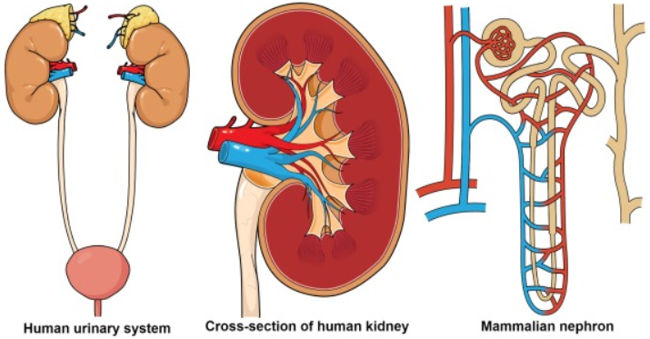
11ATAR Biology
Week 31
Animal Systems - Excretory processes

Slide 2

Year 11 Biology Work Schedule
It is important to remain on schedule during this Semester.
Moodle
Have you visited Moodle this week? Yes / No
Tasks
Are you on schedule? Yes / No
When is your next task due?

Slide 3

Learning Intentions
Understand the structure and function of the excretory system in animals.
Success Criteria
Students will be able to:
Describe the structure and function of kidneys within excretory system.
Describe the structure and function of the nephron within the kidneys.
Appreciate differences between the excretory systems of different types of animals.
Describe mechanisms to reduce water loss in animals related to their excretory system.

Slide 4
Science Understanding
- Multicellular Organisms
In animals, waste such as carbon dioxide, water, nitrogenous compounds and salts are excreted;
Different types of nitrogenous wastes are produced by the breakdown of proteins;
Most aquatic animals excrete nitrogenous wastes directly into their surroundings;
Terrestrial animals require specialised mechanisms.

Slide 5
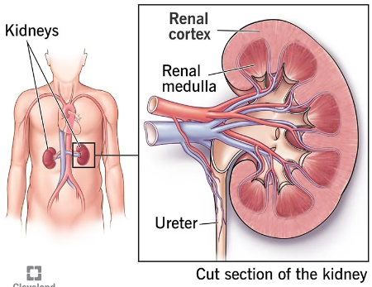
Kidneys regulate water balance
Osmoregulation
The kidneys: 1. Remove nitrogenous wastes from the body
2. Regulate water concentration in the blood
3. Maintain ion levels in the blood
Nitrogenous wastes come from the breakdown of proteins. They occur in three biological forms:
Ammonia – least toxic
Urea – intermediate toxicity
Uric acid – least toxic
Different organisms have adapted the use of one of these different waste forms depending on their environmental demands.

Slide 6
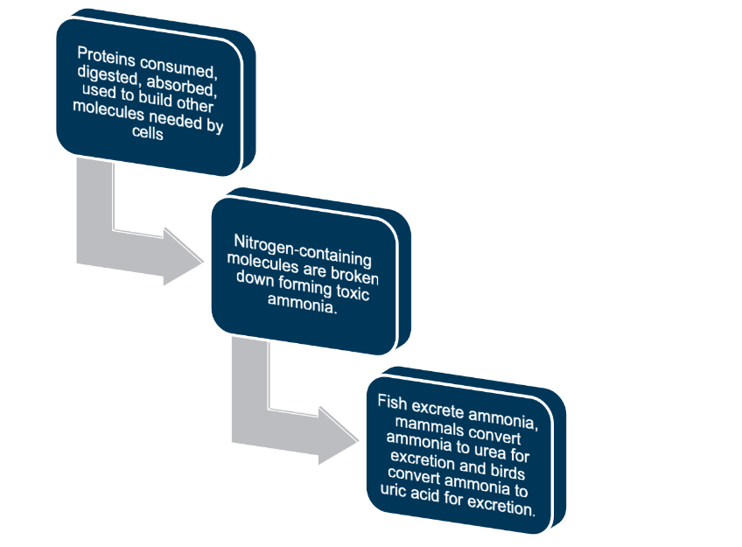
Excretory systems (Extension work)

Slide 7
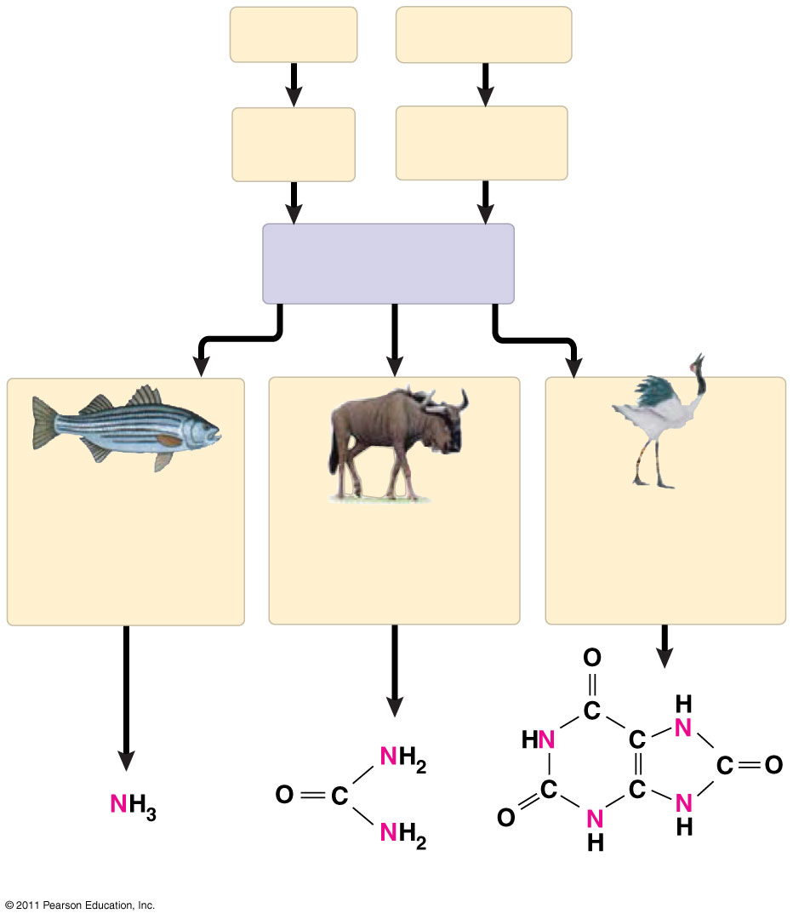
Forms of nitrogenous waste
Proteins
Nucleic acids
Amino
acids
Nitrogenous
bases
—NH₂
Amino groups
Most aquatic
animals, including
most bony fishes
Mammals, most
amphibians, sharks,
some bony fishes
Many reptiles
(including birds),
insects, land snails
Ammonia
Urea
Uric acid
Notes:
Figure 44.8 Forms of nitrogenous waste.

Slide 8
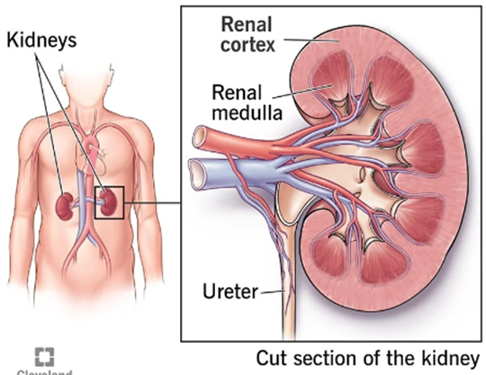
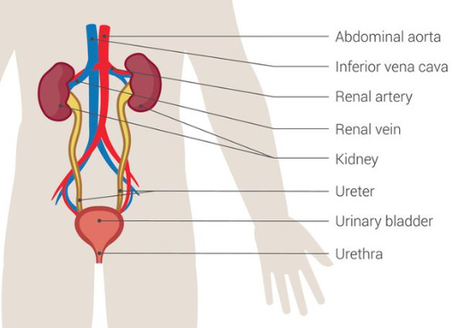
Excretory systems
The main functions of the excretory system include filtration of blood, reabsorption of water and solutes, and secretion of urine.
Excretion is the removal of nitrogen-related or other metabolic wastes.
Kidneys filter water and solutes from blood. Most of this is reabsorbed back into blood, but the excess leaves the kidneys as urine.
The body adjusts for excess water intake by increasing urine output.
Conversely, it adjusts for increased exercise or decreased water intake by reducing urine output.
The kidneys not only prevent the build-up of wastes but also help maintain water balance by controlling the volume, composition and pressure of body fluids.
Once the kidneys have finished filtering and reabsorbing, the resulting urine volume and concentration has been adjusted to enable the balance of water and removal of wastes.

Slide 9
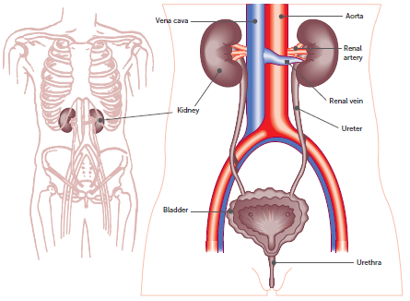
Excretory systems (Extension work)
Mammalian excretory system

Slide 10
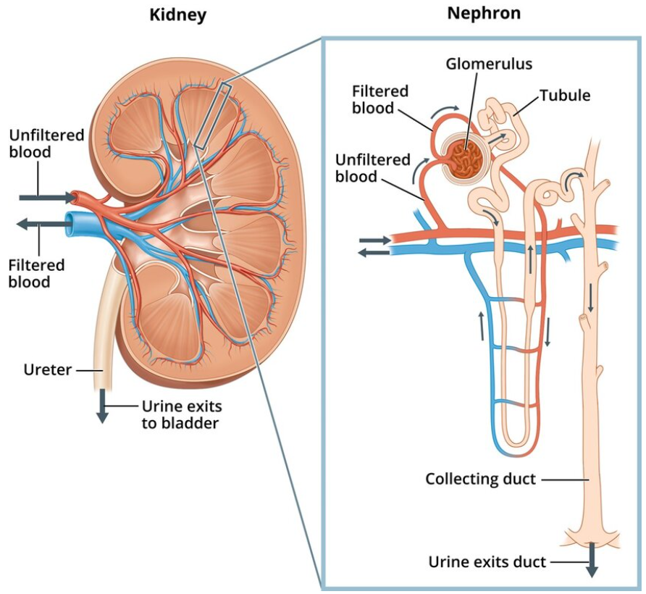
Excretory systems (Extension work)
Subunit of the kidney:- the nephron
The nephron is the basic functional unit of the kidney.
Each kidney consists of approximately one million nephrons.
Water and solutes are filtered at the start of the nephron.
During the journey through the nephron, different amounts of solutes and water are reabsorbed back into the bloodstream.
The amount reabsorbed is determined by the needs of the body.
Nephron structures relate to their function.
Mammalian nephrons collect urea, unwanted solutes and water forming urine at the end of the structure.

Slide 11
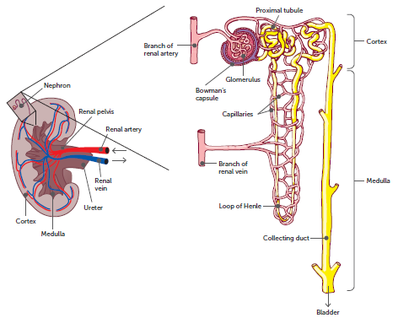
Excretory systems (Extension work)
The kidney and its functional unit, the nephron

Slide 12
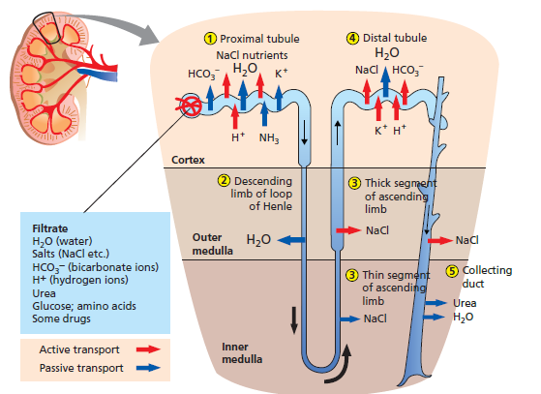
Kidneys regulate water balance
Osmoregulation
The functional unit of the kidney is the nephron.
In the glomerulus, blood plasma is filtered from fine capillaries.
Filtrate is collected in the Bowman’s capsule.
Filtrate travels through the loop of Henle, along which nutrients and proteins are reabsorbed back into the bloodstream.
Figure 8.28

Slide 13
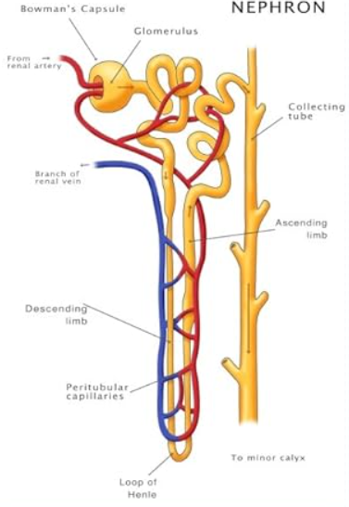
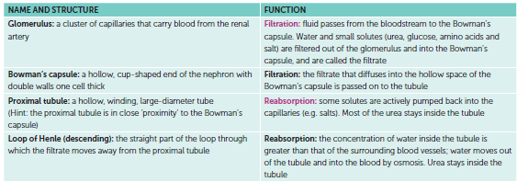
Nephron structures and functions
See pages 409 – 410 of your textbook

Slide 14

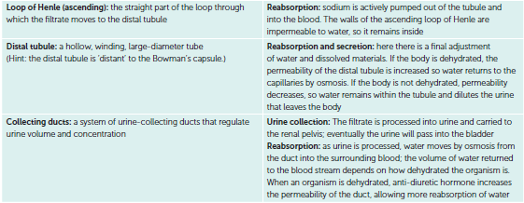
Nephron structures and functions continued…

Slide 15
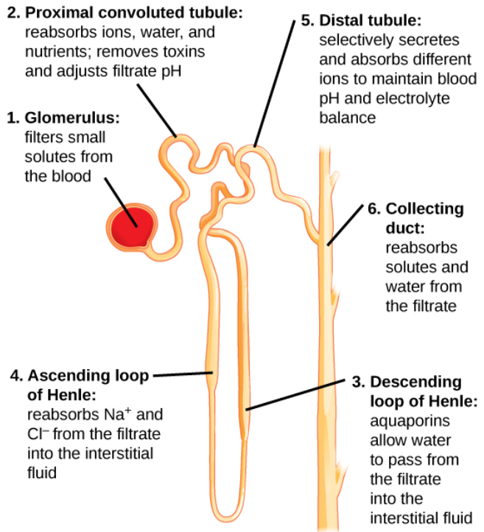
The Nephron

Slide 16
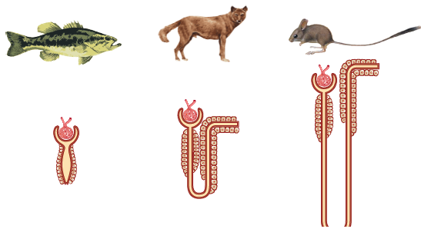
Excretory systems (Extension work)
Analyse the different nephron structure in different mammals.
How might the structure relate to the water availability in their environment?
A comparison of the structural differences in nephrons between vertebrates
Notes:
The loop of Henle occurs only in mammals and some bird kidneys, which enables these animals to produce highly concentrated urine.
The Australian Spinifex Hopping Mouse has long loops of Henle, producing very concentrated urine, absorbing enough water that it hardly needs to drink.

Slide 17
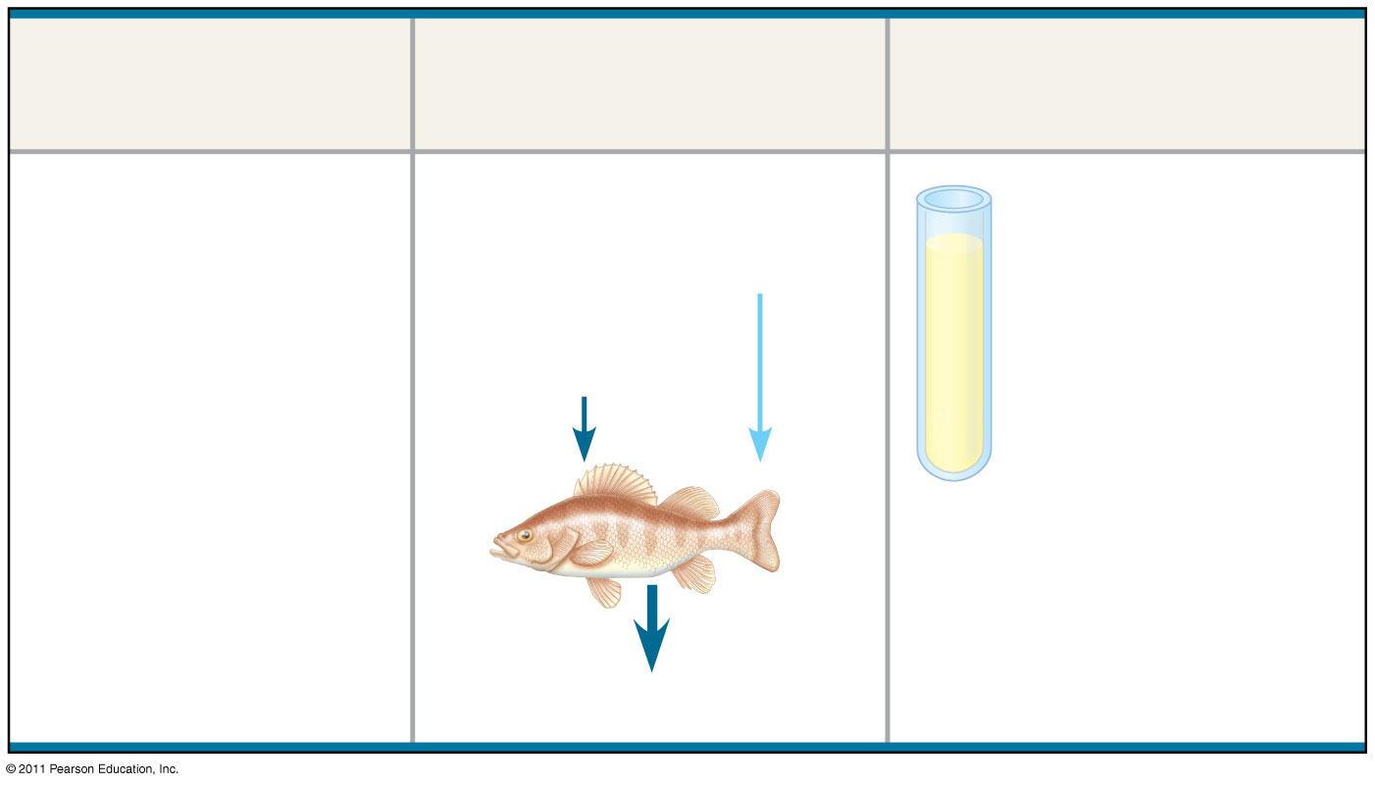
Figure 44.UN01a
Animal
Inflow/Outflow
Urine
Freshwater
fish. Lives in
water less
concentrated
than body
fluids; fish
tends to gain
water, lose salt
Does not drink water
Large volume
of urine
Salt in
(active trans-
port by gills)
H₂O in
Urine is less
concentrated
than body
fluids
Salt out
Notes:
Figure 44.UN01 Summary figure, Concept 44.1

Slide 18
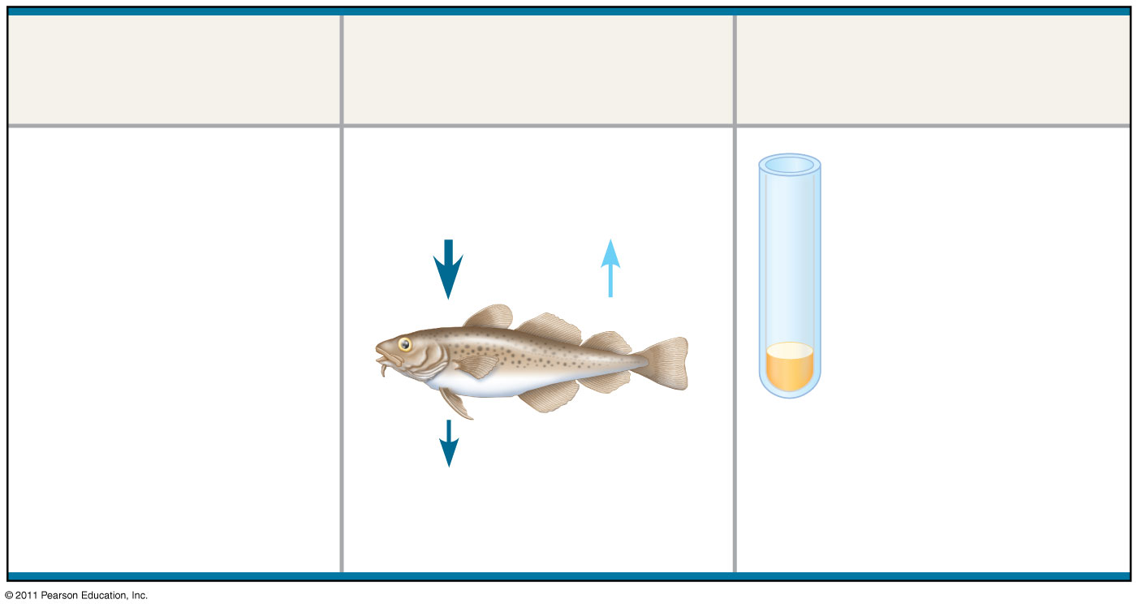
Figure 44.UN01b
Animal
Inflow/Outflow
Urine
Marine bony
fish. Lives in
water more
concentrated
than body
fluids; fish
tends to lose
water, gain salt
Drinks water
Small volume
of urine
Salt in
H₂O out
Urine is
slightly less
concentrated
than body
fluids
Salt out (active
transport by gills)
Notes:
Figure 44.UN01 Summary figure, Concept 44.1

Slide 19
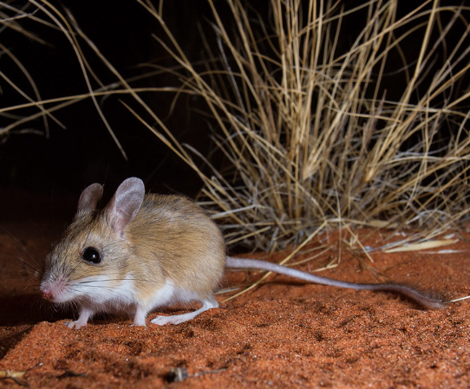
Kidneys regulate water balance
Osmoregulation
Mechanisms to reduce water loss include:
Reptiles and birds reabsorb water from their cloaca, the cavity into which their ureter and rectum open.
Terrestrial vertebrates can slow the production of urine by reducing the glomerular filtration rate.
The Australian desert frog can also swell and store its urine for use in the dry season.
Having longer loops of Henle allow organisms to concentrate their urine.
The desert hopping mouse Notomys alexis can concentrate its urine more than any other known rodent.
Camels can tolerate water loss and concentration of their body’s fluids.

Slide 20

Learning Intentions
Understand the structure and function of the excretory system in animals.
Success Criteria
Students will be able to:
Describe the structure and function of kidneys within excretory system.
Describe the structure and function of the nephron within the kidneys.
Appreciate differences between the excretory systems of different types of animals.
Describe mechanisms to reduce water loss in animals related to their excretory system.

Slide 21
Student Feedback
What I learnt today…..
What I need to revise….
Notes:
Pivot Survey: https://survey.pivotpl.com/login/sst/KWUEP

